Slide 1


20EC5203 ELECTRONIC DESIGN PROJECT- I MODULE 1 - THE THIRD EYE MODULE 2 - THE SMART TRASH
Presented by:
NANDHINI G (811722106061)
SHANKAR SHARMA K J (811722106099)
THANUSH SARAN S (811722106119)
Under the Guidance of
Dr.M.Ashokraj
Assistant professor
Department of ECE
BATCH-36
1
Saturday, December 7, 2024
EDP I REVIEW
Notes:
1

Slide 2
OUTLINE
ABSTRACT
INTRODUCTION
LITERATURE REVIEW
EXISTING METHOD
OBJECTIVE
PROPOSED METHOD
HARDWARE MODULE
HARDWARE & SOFTWARE INVOLVED
RESULTS AND DISCUSSION
ADVANTAGES AND APPLICATION
CONCLUSION
REFERENCES
2
Ciat II Review
Saturday, December 7, 2024
EDP I REVIEW
Notes:
2

Slide 3
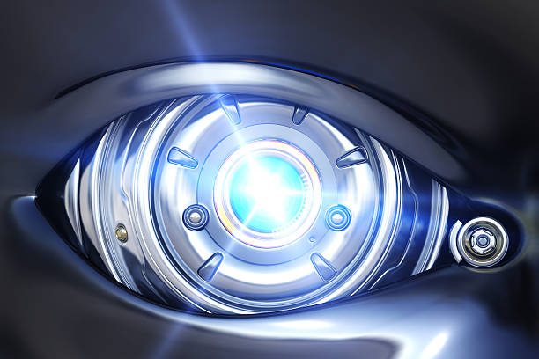
MODULE 1 - THE THIRD EYE
3
EDP I REVIEW

Slide 4
ABSTRACT
In industrial settings, machinery poses significant risks of injuries to workers due to unintentional contact, malfunction, or human error. The Third Eye project aims to address these risks by developing an advanced electronic eye system for enhanced safety. By utilizing ultrasonic sensors and a robust control mechanism, the project seeks to prevent accidents, reduce operational disruptions, and ensure compliance with industrial safety standards. This innovation can lead to improved workplace safety, increased productivity, and a healthier working environment.
EDP I REVIEW
Saturday, December 7, 2024

Slide 5
INTRODUCTION
The Third Eye project aims to address the pressing need for improved safety in industrial environments, where machinery-related hazards pose significant risks to workers.
This project focuses on developing an advanced safety system designed to prevent accidents caused by human error, equipment malfunctions, or unintentional contact with hazardous machinery.
By creating a cost-effective and scalable solution, the project ensures accessibility for industries of all sizes, adhering to safety regulations and standards to protect workers effectively.
Ultimately, the Third Eye project seeks to foster safer industrial environments, enhancing productivity and worker well-being through innovative sensor technology.
EDP I REVIEW
Saturday, December 7, 2024

Slide 6
OBJECTIVE AND SCOPE
OBJECTIVE
Enhance Worker Safety: Develop or improve electronic eye systems to reduce the risk of accidents and injuries in industrial settings.
Improve Detection Accuracy: Increase the precision of detecting potential hazards in real-time to prevent accidents before they occur.
SCOPE
Integration with Machinery: Seamlessly integrate the safety system into existing industrial machinery without significant modifications. Develop an advanced electronic eye system that covers broader areas with minimal blind spots.
Compliance with Safety Standards: Ensure the system meets industrial safety standards and regulations, enhancing worker protection while maintaining operational efficiency.
6
EDP I REVIEW

Slide 7
LITERATURE SURVEY
REF. NO | TITLE & AUTHOR | METHODOLOGY OR COMPONENTS USED | PROS | CONS
1 | "Advanced Safety Systems in Industry" - J. Smith | Photoelectric sensors for motion detection | Real-time hazard detection, easy to install | Limited range, prone to false triggers in dusty environments
2 | "Human-Machine Safety Integration" - A. Patel | Integration of electronic eyes with machine automation | Automated safety response, reduces human error | High installation cost, requires system compatibility
3 | "Workplace Safety with Sensors" - B. K. Reddy | Multiple sensor layers including infrared and pressure sensors | Accurate hazard detection, covers wider areas | Complex setup, regular maintenance needed
4 | "Smart Sensor Technologies for Industry" - M. Lee | AI-powered electronic eye with machine learning capabilities | Self-learning system, adapts to changing environments | Expensive, requires high computational power
5 | "Industrial Safety Mechanisms" - T. Hernandez | Combination of electronic eye with safety barriers | Dual protection, improves overall safety | Slows down operations, physical barriers can be bypassed
7

Slide 8
BLOCK DIAGRAM
Power Supply
Battery/Switch
NE-555 IC
Ultrasonic Sensor
Resistor
Buzzer
Capacitor
Potentiometer
EDP I REVIEW
Saturday, December 7, 2024

Slide 9
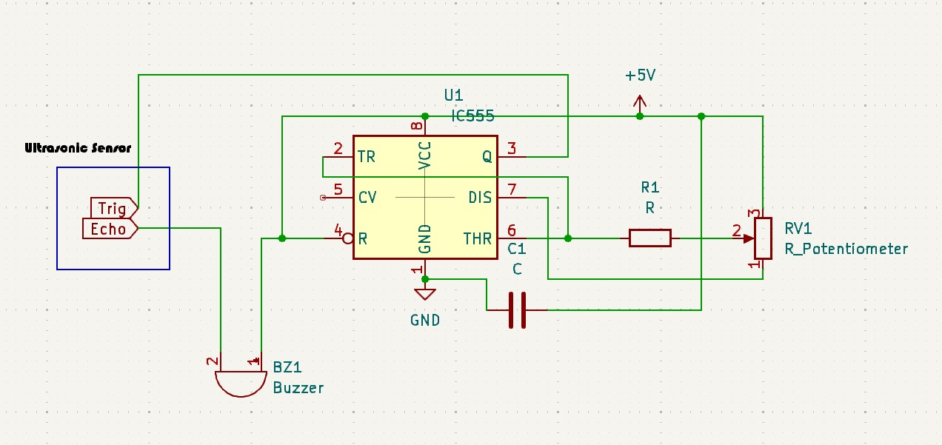
CIRCUIT DIAGRAM
EDP I REVIEW
Saturday, December 7, 2024

Slide 10
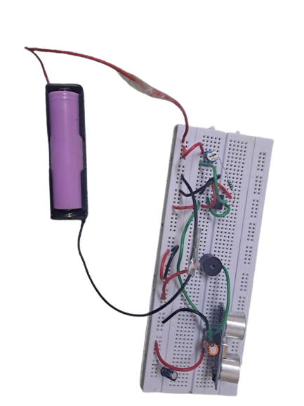
HARDWARE MODULE
10
Video Link: https://drive.google.com/file/d/1B1C2Py8T0H4QMlQv8qTJExNTibRLzvV4/view?usp=drivesdk
10
EDP I REVIEW
Saturday, December 7, 2024

Slide 11
HARDWARE INVOLVED
HARDWARE COMPONENTS
Ultrasonic Sensor-1
NE-555 Timer IC-1
Potentiometer-1
Buzzer-1
Resistor-2 (1KΩ)
Capacitors-1 (100µf)
Battery-1
Switch-1
Connecting Wires-As Required
11
EDP I REVIEW
Saturday, December 7, 2024

Slide 12
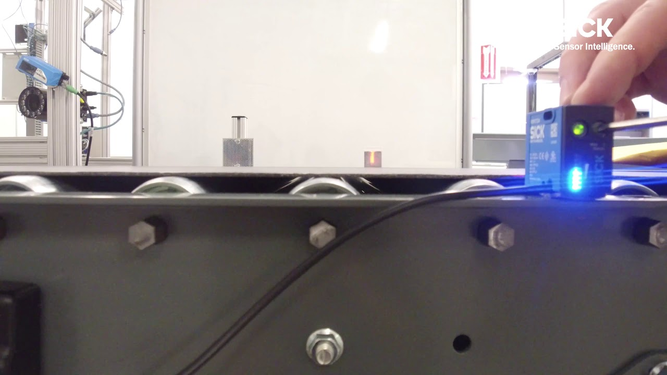
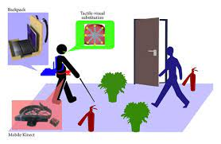
APPLICATIONS & ADVANTAGES
APPLICATIONS
Industrial Safety
Manufacturing Plants
Warehouses & Storage Facilities
Automated Production Lines
Construction Sites
ADVANTAGES
Improved Worker Safety
Cost-Effective
Real-Time Monitoring
Adjustable Sensitivity
Easy Integration
Low Maintenance
Enhanced Productivity
Scalable Solution
EDP I REVIEW
Saturday, December 7, 2024

Slide 13
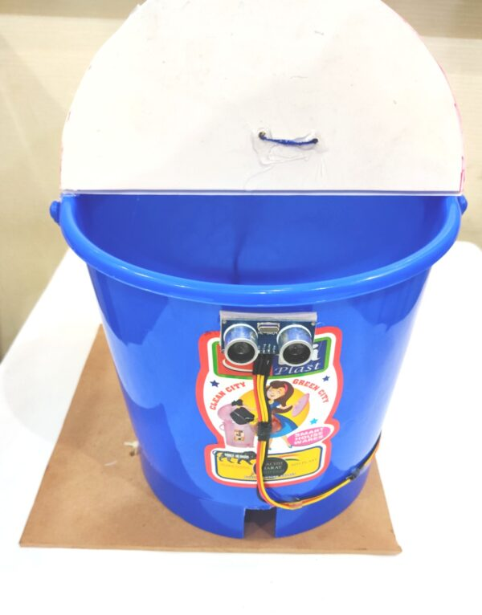
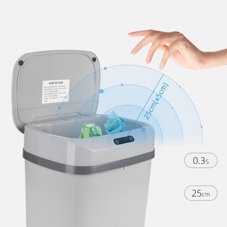
MODULE 2 - THE SMART TRASH
EDP I REVIEW

Slide 14
ABSTRACT
The Smart Trash project introduces an automated, touchless trash bin system that enhances hygiene by using infrared sensors to detect human presence and automatically open the lid. It reduces physical contact, minimizes germ spread, and optimizes waste disposal. The system includes real-time feedback to alert users when the bin is full or needs maintenance, offering a sustainable, energy-efficient solution for waste management in high-traffic areas like parks, malls, and office buildings.
EDP I REVIEW
Saturday, December 7, 2024

Slide 15
INTRODUCTION
The Smart Trash project addresses the growing need for efficient and hygienic waste disposal systems, particularly in high-traffic public spaces. Traditional trash bins often require manual operation, which can lead to hygiene concerns, user discomfort, and improper waste disposal.
This project proposes an automated solution using infrared sensors to detect human presence and open the bin lid without physical contact, thus reducing the spread of germs and promoting cleaner environments. By automating the process, the system ensures that waste is disposed of properly, while real-time feedback alerts users when the bin is full or needs maintenance.
Designed for ease of use, energy efficiency, and minimal maintenance, the Smart Trash system aims to improve waste management in public parks, malls, offices, and other high-traffic areas, contributing to healthier, cleaner spaces and reducing human error in waste disposal.
Saturday, December 7, 2024
EDP I REVIEW

Slide 16
OBJECTIVE AND SCOPE
OBJECTIVE
Enhance Hygiene: Develop a smart trash bin that minimizes physical contact, reducing the spread of germs and promoting cleaner public spaces.
Improve Waste Disposal: Encourage proper waste disposal by making it easier and more convenient for users to access the bin.
SCOPE
Design and Development: Create a prototype of the smart trash bin, incorporating infrared sensors, touchless operation mechanisms, and an automatic closing feature.
Deployment: Plan for the installation of smart trash bins in strategic locations, such as parks, malls, and public buildings. Develop a user feedback mechanism to gather insights for future improvements and enhancements.
EDP I REVIEW

Slide 17
LITERATURE SURVEY
REF. NO | TITLE & AUTHOR | METHODOLOGY OR COMPONENTS USED | PROS | CONS
1 | "IoT-Based Smart Waste Management System" - J. Doe | Utilizes IoT sensors for fill level and motion detection | Improves waste collection efficiency, reduces costs | High initial setup costs, requires technical expertise
2 | "Touchless Technology in Public Spaces" - A. Smith | Incorporates infrared sensors for hands-free operation | Enhances hygiene, minimizes physical contact | Possible interference from environmental factors
3 | "Smart Trash Bins: A Case Study" - B. Reddy | Combines ultrasonic sensors with a solar power system | Eco-friendly, reduces energy costs | Dependence on sunlight for power, may not work in shaded areas
4 | "Designing User-Friendly Waste Solutions" - M. Lee | User-centered design approach with feedback mechanisms | Increases user engagement and satisfaction | May require continuous updates based on user feedback
5 | "Environmental Impact of Smart Waste Solutions" - T. Hernandez | Analyzes data from smart bins on recycling and waste levels | Reduces littering, promotes recycling | Implementation challenges in older urban areas
17

Slide 18
BLOCK DIAGRAM
Power Supply
Battery/Switch
Relay
IR Sensor
Switch
Servo Motor
Capacitor
Potentiometer
EDP I REVIEW
Saturday, December 7, 2024

Slide 19
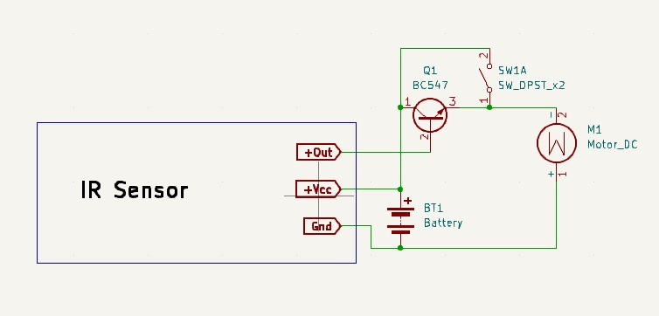
CIRCUIT DIAGRAM
EDP I REVIEW
Saturday, December 7, 2024

Slide 20
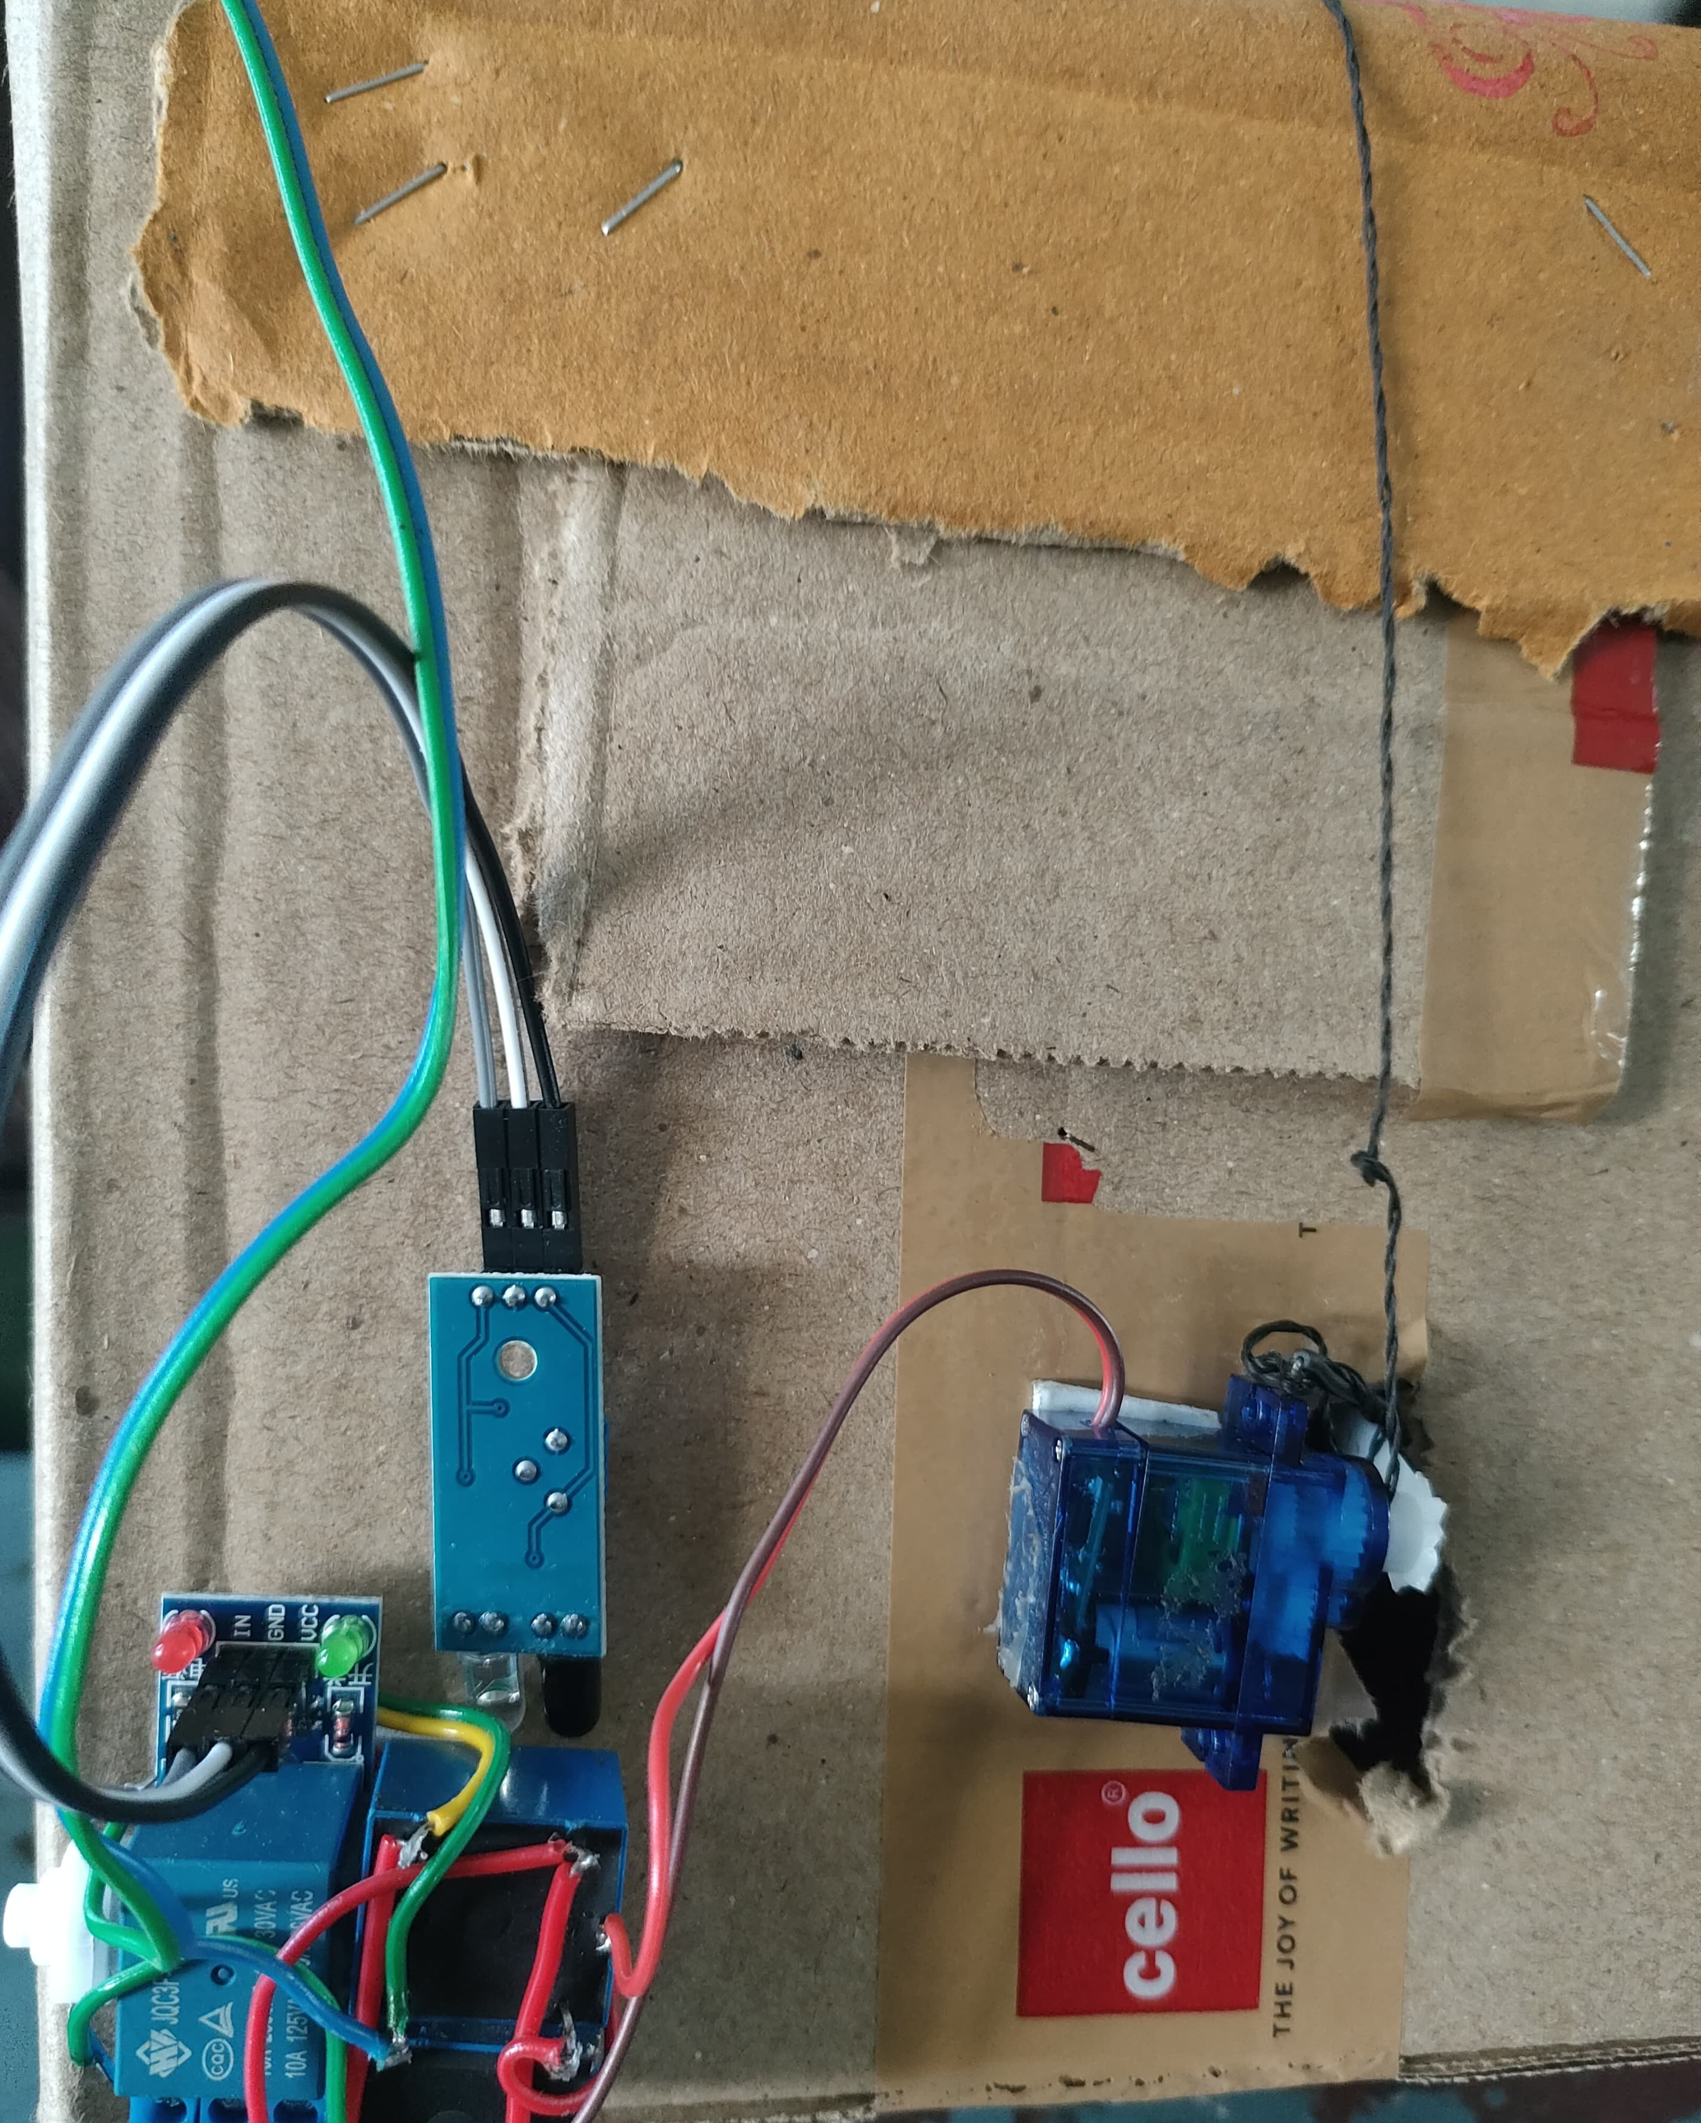
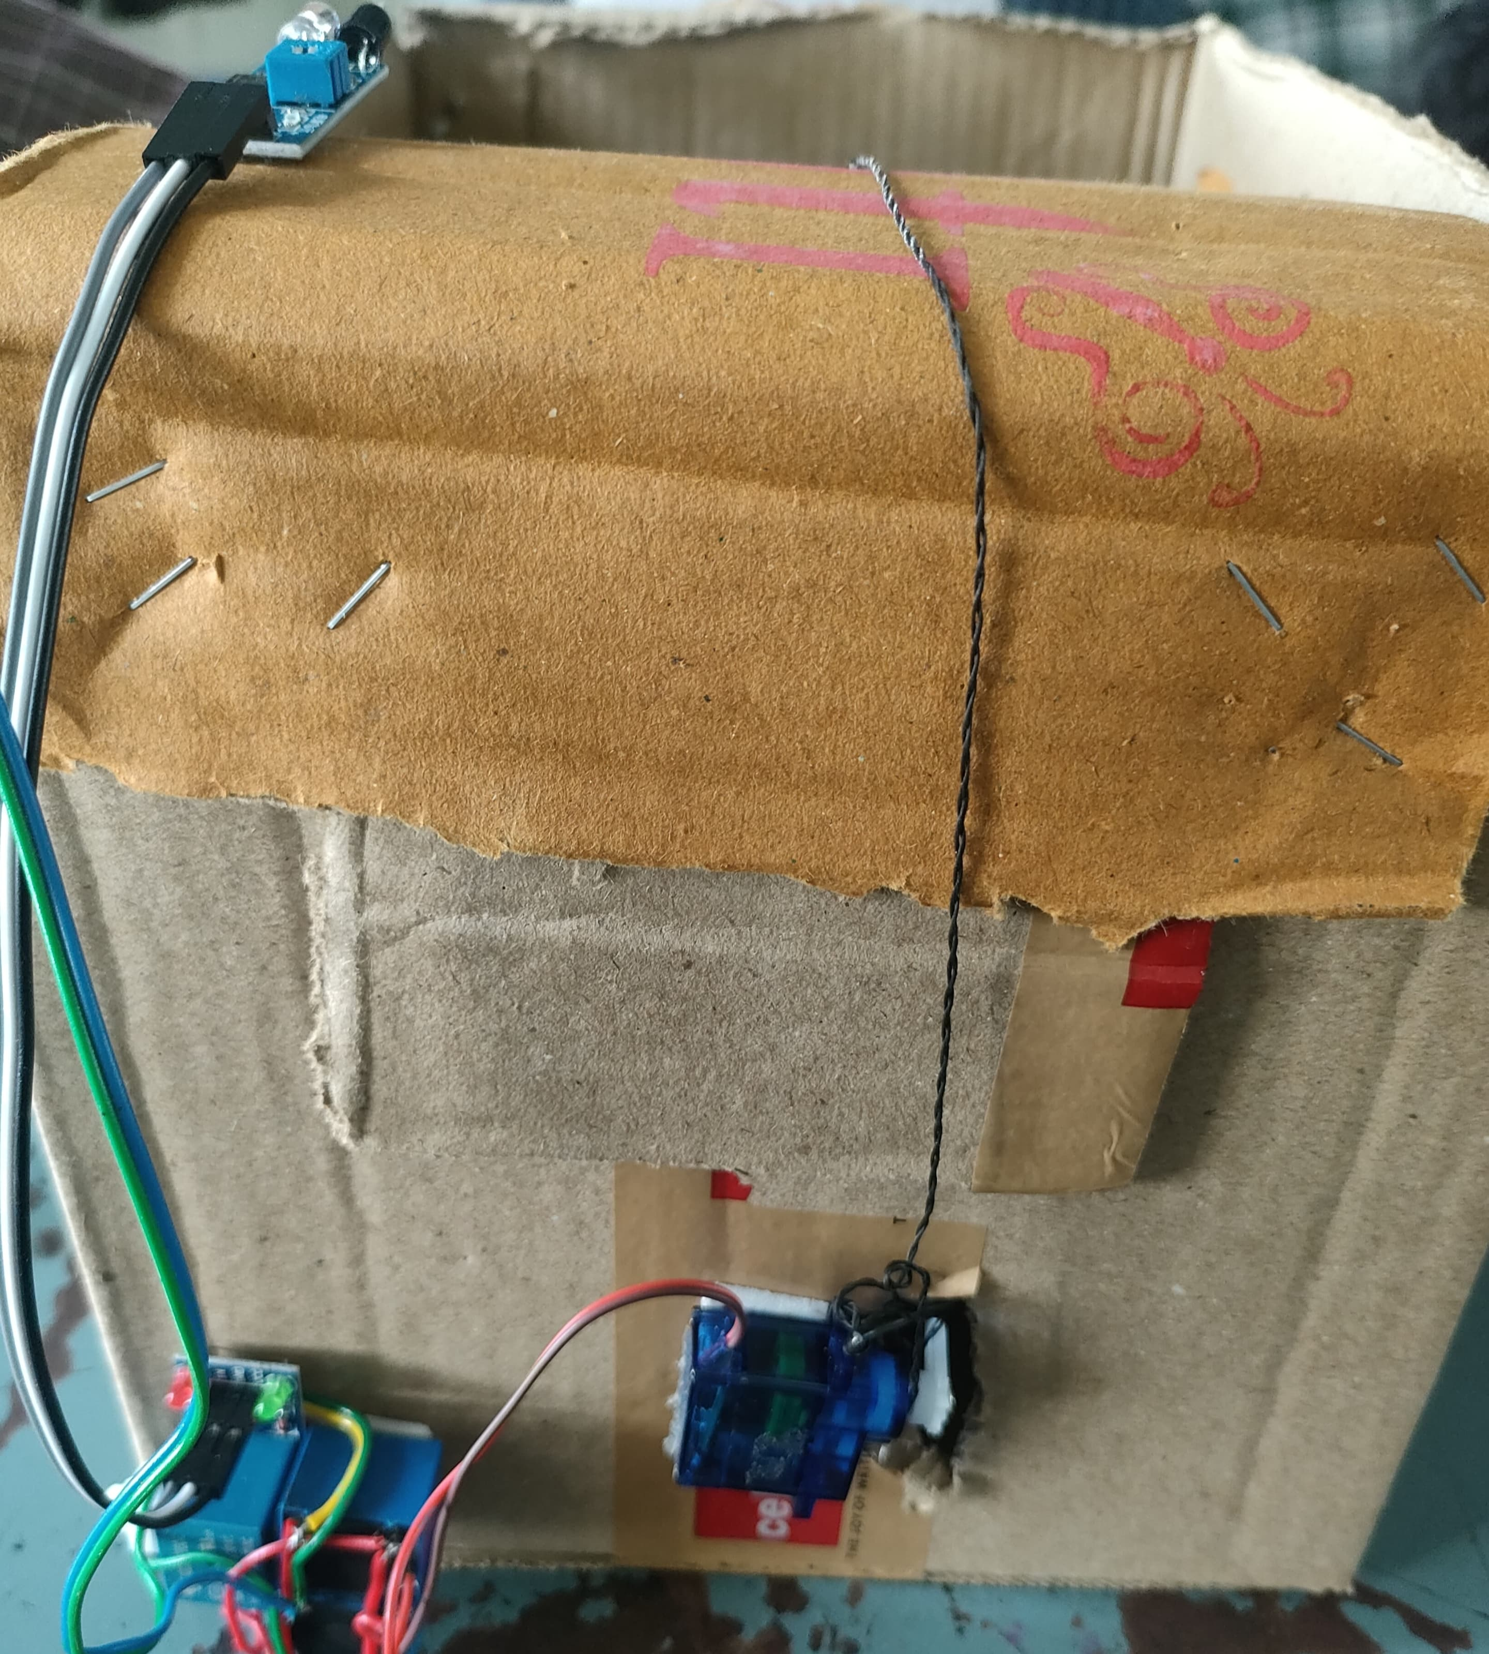
HARDWARE MODULE
20
Video Link: https://drive.google.com/file/d/1B6Ft1GE05H_Fj1Z7PrP5TadOFRmb1bIA/view?usp=drivesdk
20
EDP I REVIEW
Saturday, December 7, 2024

Slide 21
HARDWARE INVOLVED
HARDWARE COMPONENTS
Infrared (IR) Proximity Sensor-1
Servo Motor-1
Battery-1
Relay-1
Switch-1
Potentiometer-1
Jumper Cables-As Required
21
EDP I REVIEW
Saturday, December 7, 2024

Slide 22
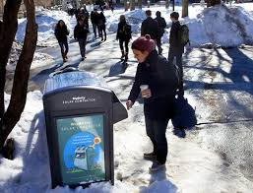
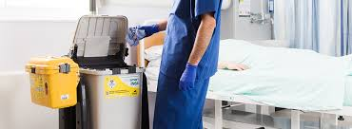
APPLICATIONS & ADVANTAGES
APPLICATIONS
Public Spaces
Office Buildings
Healthcare Facilities
Educational Institutions
Event Venues
ADVANTAGES
Enhanced Hygiene
Energy Efficiency
Convenience
Real-Time Monitoring
Cost-Effective
User-Friendly Design
Reduced Labor Costs
Scalable Solution
EDP I REVIEW
Saturday, December 7, 2024

Slide 23
CONCLUSION
The Third Eye project provides an automated industrial safety system that detects hazards in real-time and alerts workers, significantly reducing the risk of accidents and improving workplace safety.
The Smart Trash system offers a touchless, energy-efficient waste disposal solution that improves hygiene, optimizes waste management, and reduces manual labor through automated monitoring and real-time feedback.
EDP I REVIEW
Saturday, December 7, 2024

Slide 24
REFERENCES
Bhat, R. S. K. (2021). Industrial Safety: Concepts, Methods, and Applications. Journal of Industrial Engineering, 10(3), 45–58.
Gupta, M. K. (2020). Automation in Industrial Safety Systems. Automation Systems Review, 8(2), 12–25.
Reiss, P. M. L. A. (2018). Sensors and Actuators: Engineering System Instrumentation. Engineering Instrumentation Journal, 5(4), 67–79.
Patel, A. (2019). Human-Machine Safety Integration. Safety Systems Quarterly, 6(1), 18–32.
Hernandez, T. (2022). Ultrasonic Sensors in Industrial Applications. Sensors and Systems Journal, 7(3), 56–68.
Doe, J. (2023). IoT-Based Smart Waste Management System. IoT Innovations Journal, 9(1), 25–37.
Smith, A. (2020). Touchless Technology in Public Spaces. Technology and Society Journal, 12(2), 45–52.
Reddy, B. (2021). Smart Trash Bins: A Case Study. Waste Management Studies, 4(2), 15–23.
Lee, M. (2019). Designing User-Friendly Waste Solutions. Sustainability Review Journal, 3(4), 30–42.
Hernandez, T. (2023). Environmental Impact of Smart Waste Solutions. Environmental Technology Reports, 8(2), 50–60.
Zeroth Review
Saturday,August,10,2024
24
EDP I REVIEW
Saturday, December 7, 2024

Slide 25
THANK YOU
25
*
EDP I REVIEW
Saturday, December 7, 2024

